Slide 1
Yanfeng Visteon SUPPLIER APQP PORTAL
Project Discussion / 项目讨论
Jan 3rd 2018
V10.0

Slide 2
Agenda/议程
Introductions / 介绍
Omnex Project Team / 奥曼克项目组
Visteon Team. / 延锋项目组
Omnex Strength & Capabilities / 奥曼克优势&能力
Omnex understanding of Project / 奥曼克对项目的理解
Current Status of the Project / 项目当前状态
Discuss on Project Time plan, Open issues / 讨论项目时间计划，问题
Next Steps下一步

Slide 3
Omnex – Customer Facing Project Team / 奥曼克-项目组
S.No / 序号 | Name / 名称 | Project Role / 项目角色
1. | Clarence Jiang | Subject Matter Expert
2. | Michael Zhu | Business Analyst
3. | R S Sabu | Delivery Manager
4. | Wendy Wan | Sales Manager – Consulting and Training
5. | Dora Yin | Sales Manager - Software
6. | Christin Varghese | Implementation Manager
7. | Sharon Su & Evin Xiong | Implementers
8. | Antony John & Michael Xu | Program Managers

Slide 4




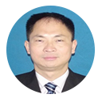






Omnex Project Org Chart / 奥曼克项目组织架构图
Chad Kymal, Arun Kumar, Dave Watkins
TOP MANAGEMENT / 最高管理层
Michael Xu | Antony John
Michael Zhu
Sharon
Evin Xiong
Global Software Development
Christin
Business Analyst Team
R S Sabu
Clarence Jiang
Dora Yin
Wendy Wan
Development Team will be based out of Shanghai, India & USA.
开发团队将在上海，印度和美国

Slide 5
Yanfeng Visteon Project Team
Site / 站点 | Name / 名称 | Project role / 项目角色
Songjiang | Li Zhuo | Project Lead
 | Wang Jianjun | Key User
 | Zhang Yuanhua | Key User
 | Wang Zheyu | Key User
 | Zheng Jian | Key User
 | Hong Xiaodong | Key User
YFVIC | Wu Leilei | Project CO-Lead

Slide 6

Omnex, Ford and Visteon – Relationship
Helped Ford Powertrain asked Omnex to work with poor suppliers that they wanted to keep in the supply base.
These suppliers had bad quality records and were scoring poorly in Ford Q101 assessments.
Omnex created a name and reputation by doing turn arounds of Ford’s most difficult suppliers.
1987
Ford reached out to Omnex to help as they rewrote the Ford QOS standard.
Omnex also helped in the rewrite of QOS Standard.
1991
Omnex supported Ford with their emerging market strategy in Thailand, India, Vietnam, Brazil.
We rolled out an integrated QS 9000, APQP, and QOS model for Ford and Ford Suppliers.
2000’s
Omnex was approached by Visteon in 2002 to help support Visteon troubled suppliers in the US.
Omnex also trained Visteon Asia supply base training in Taiwan, Malaysia, India and Thailand. Since supported Visteon by conducting training and assessments as requested.
2002
Omnex provided this support in the US for the Visteon supply base and
successfully worked on multiple suppliers during 2002 to 2008
2002-2008

Slide 7
Omnex, Ford and Visteon – Journey continues…
The current Ford QOS standard at Ford is a result of the rewrite that we rolled out for Ford starting in 1993. Omnex’s BOSS module reflects the Ford QOS standard. Omnex helped Ford globally with this standard in multiple ways from writing the QOS assessment that was used with Ford Q1 and helping several divisions implement this. Omnex’s involvement in Ford QOS went all the way to the Ford Board.
Omnex supported Visteon in the US with training in multiple areas. Especially, Omnex supported Visteon in SQE training. We conducted SQE training for Visteon similar to how we did it for Ford Motor Company.
Omnex continues to provide SQE training for Ford Asia Pacific
Omnex had a process for supplier development very successfully used with Ford Motor Company and later with Daimler Chrysler
When ISO TS 16949 was launched in 2002, Omnex provided global Visteon training. Not only did Omnex train Visteon in NA. we did it across the globe. Some of the topics included -
ISO TS 16949
Internal Auditor and Lead Auditor
APQP, MSA, SPC, and FMEA, and PPAP
Problem Solving 8-D
Many Ford and Visteon employees work for Omnex who have had roles as Quality Manager, SQE leader, Ford Corporate Lean Office, Asia Pacific Training Dean, and others.
Omnex till date, continues to provide training for Visteon in several parts of the globe.

Slide 8
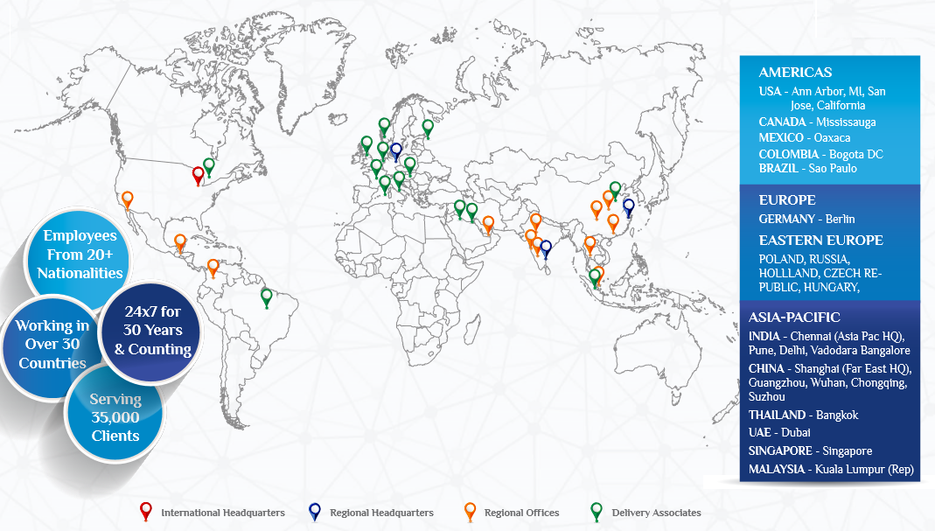

Omnex worldwide offices / 奥曼克全球办公室
v

Slide 9

OMNEX GROUP SNAPSHOT

Slide 10


Project Scope / 项目范围

Slide 11


YANFENG SUPPLIER APQP PORTAL / 延锋供应商APQP入口
SUPPLIER
METRICS /
供应商指标
PROJECT /
PROGRAM
MGMT
项目/程序（大项目）管理
SUPPLIER
PORTAL
供应商入口
Supplier
APQP
PORTAL
供应商
APQP入口
DOCUMENT
MGMT/
文档管理
ISSUES / RISK
MGMT
/问题/风险管理

Slide 12


Yanfeng Visteon - Supplier APQP Portal
YANFENG Internal User
Supplier Portal
Yanfeng APQP Modules
Supplier Modules
S
O
A
User Home Page, Supplier Management, APQP Program Management, Report Manager, Task Management, Issue Management, Document Management, Project Template Management, System Setup
Supplier Home Page, Supplier APQP/PPAP Program, Supplier Task, Supplier Issues, Supplier Actions, Supplier Document, Supplier News, Supplier Calendar
BPM
Business Processes
Project Plan Release
Issue Management
TR
Document Review
Supplier Document Release
SCR
Components
Business Component
Workflow/Rules Engine
Document Repository
Program Template
Gate Review Checklist
Activity Directory Integration
SOA
(System Connectivity)
PPQP
Checklist
Project Deliverable Review Checklist
Database

Slide 13

Software Prototypes / 软件原型

Slide 14
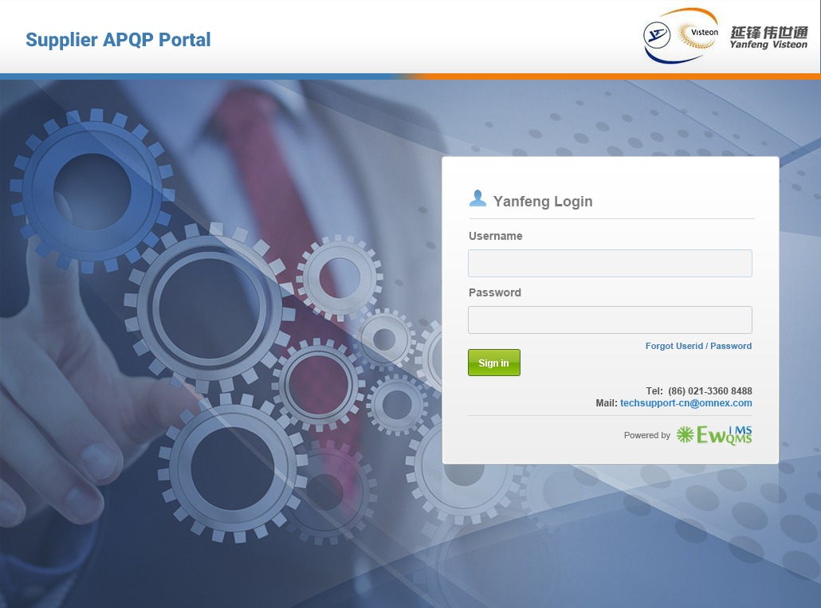


Slide 15
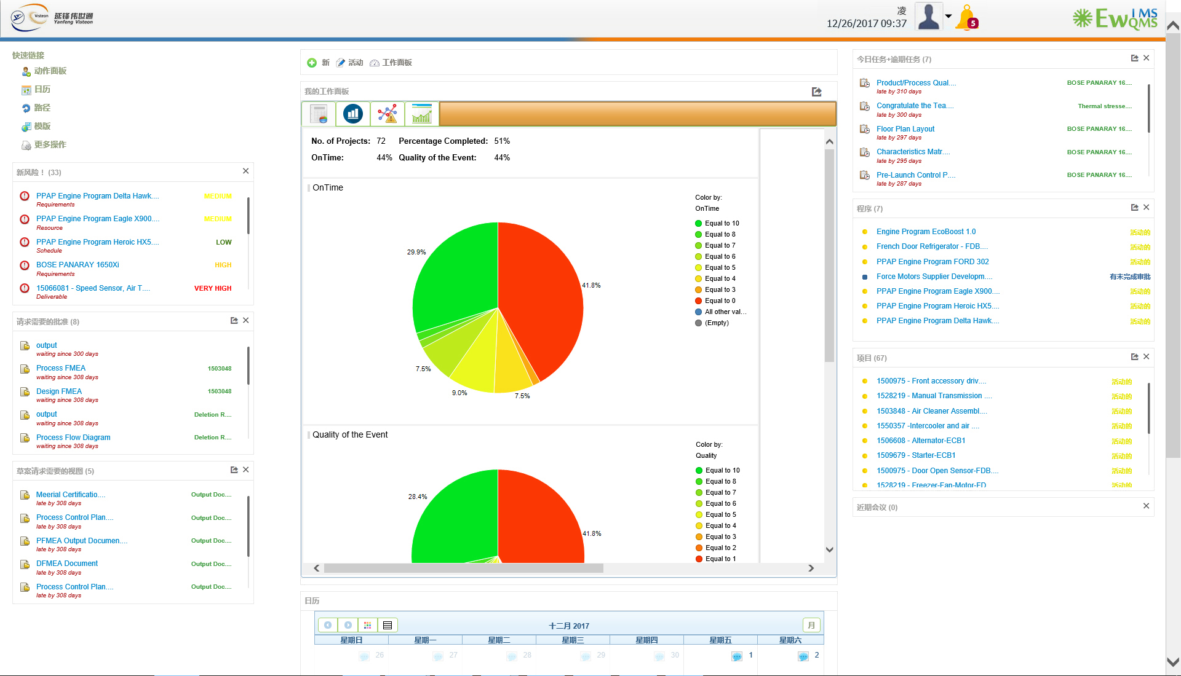

Slide 16
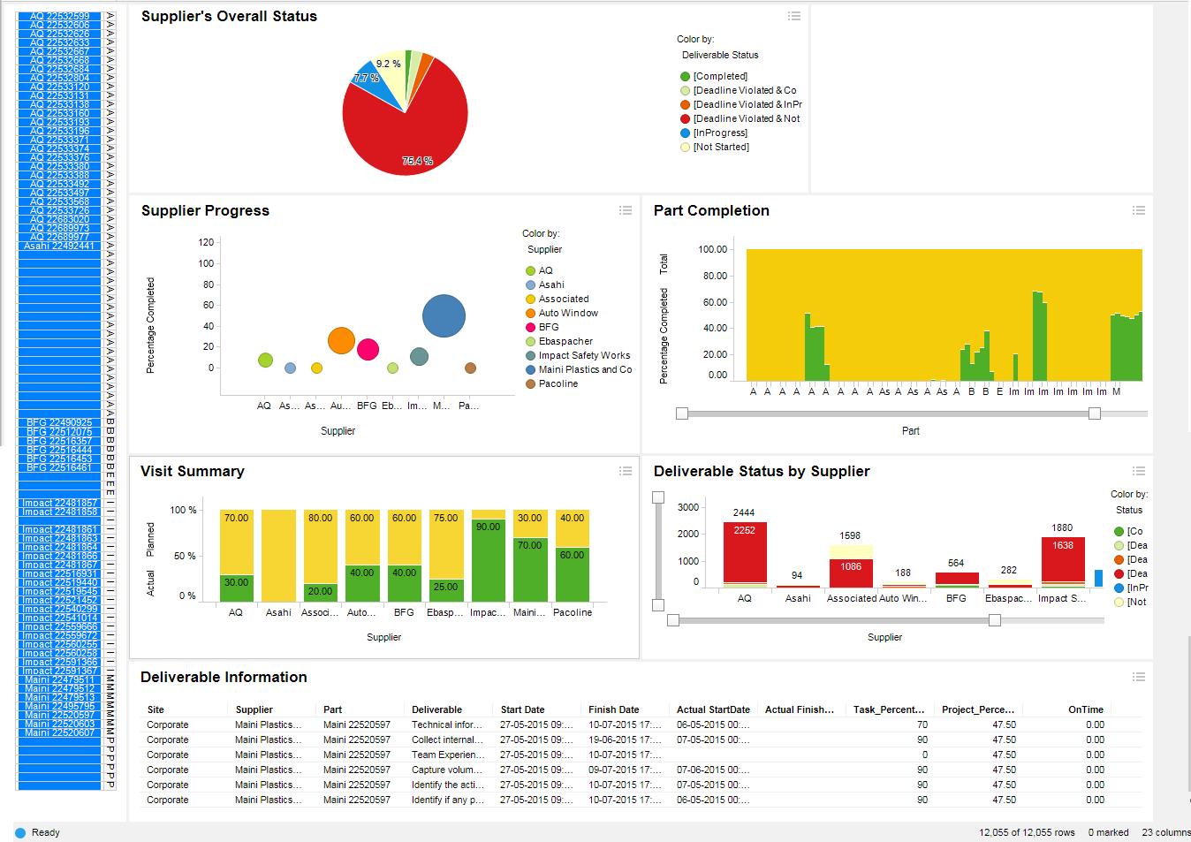
Supplier Dashboard / 供应商管理汇总表
v

Slide 17
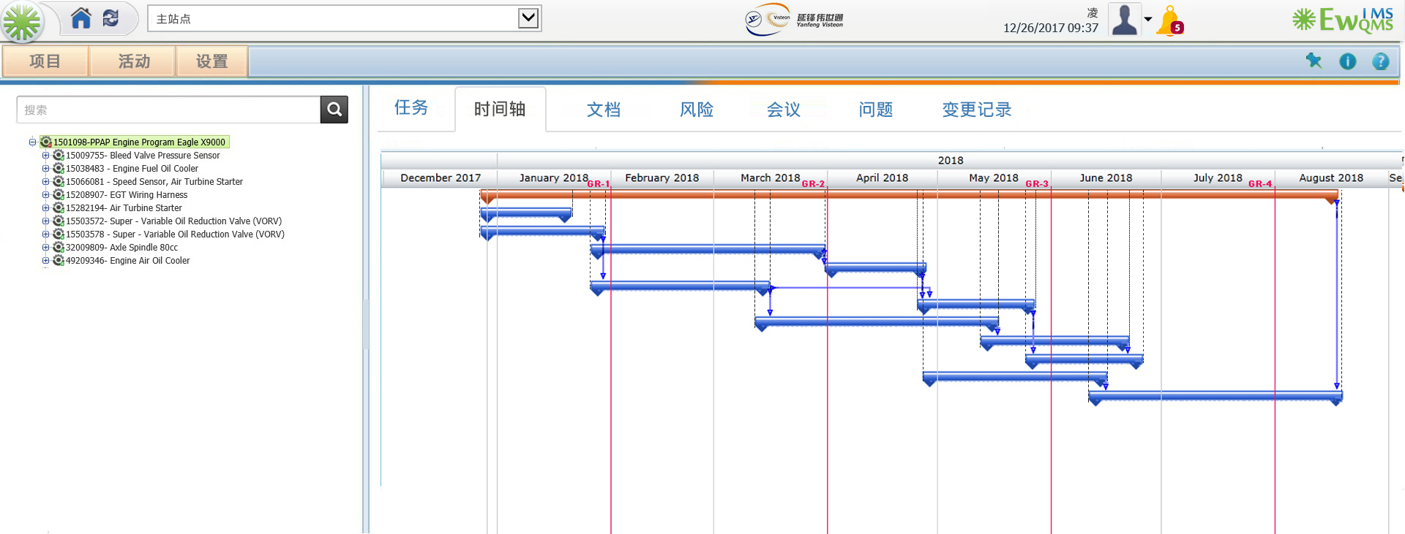

Slide 18
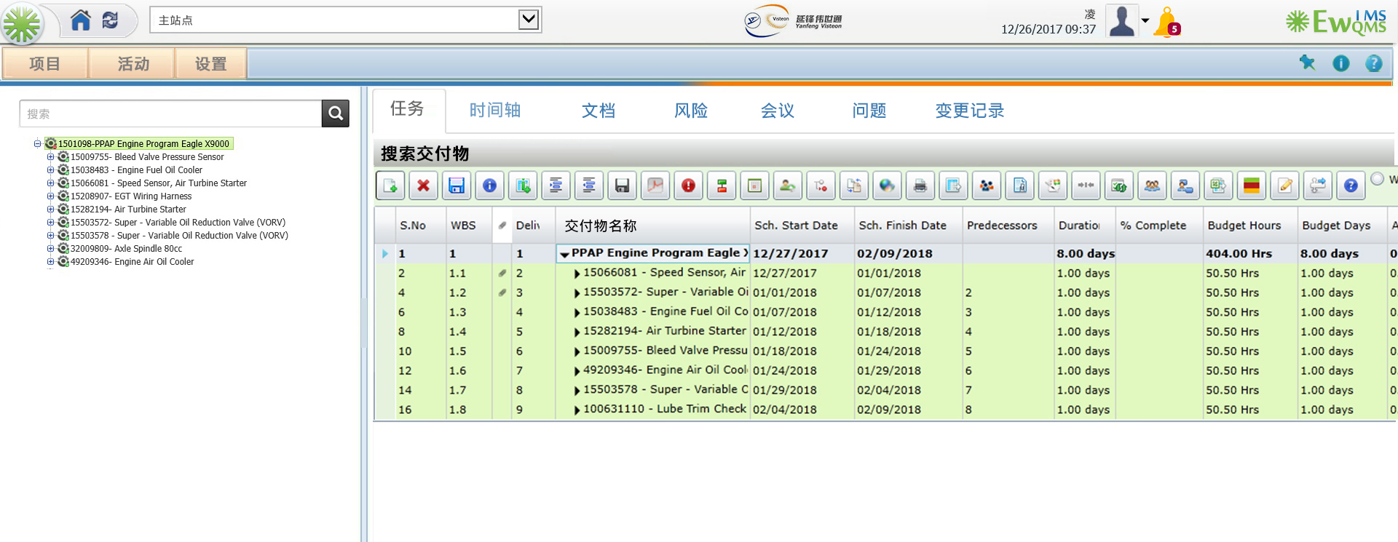

Slide 19
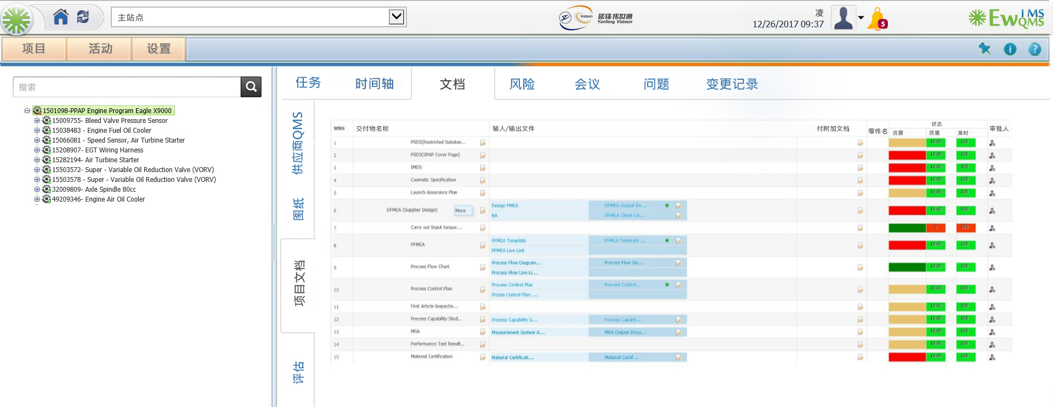

Slide 20
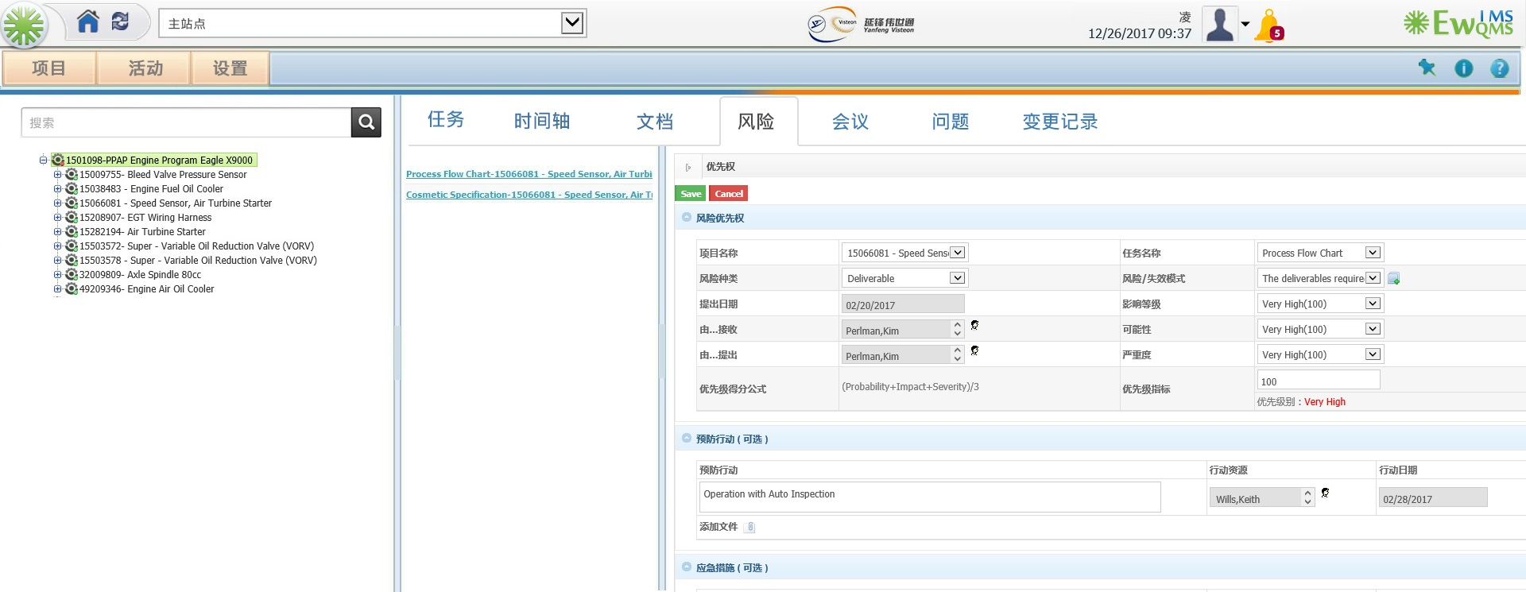

Slide 21
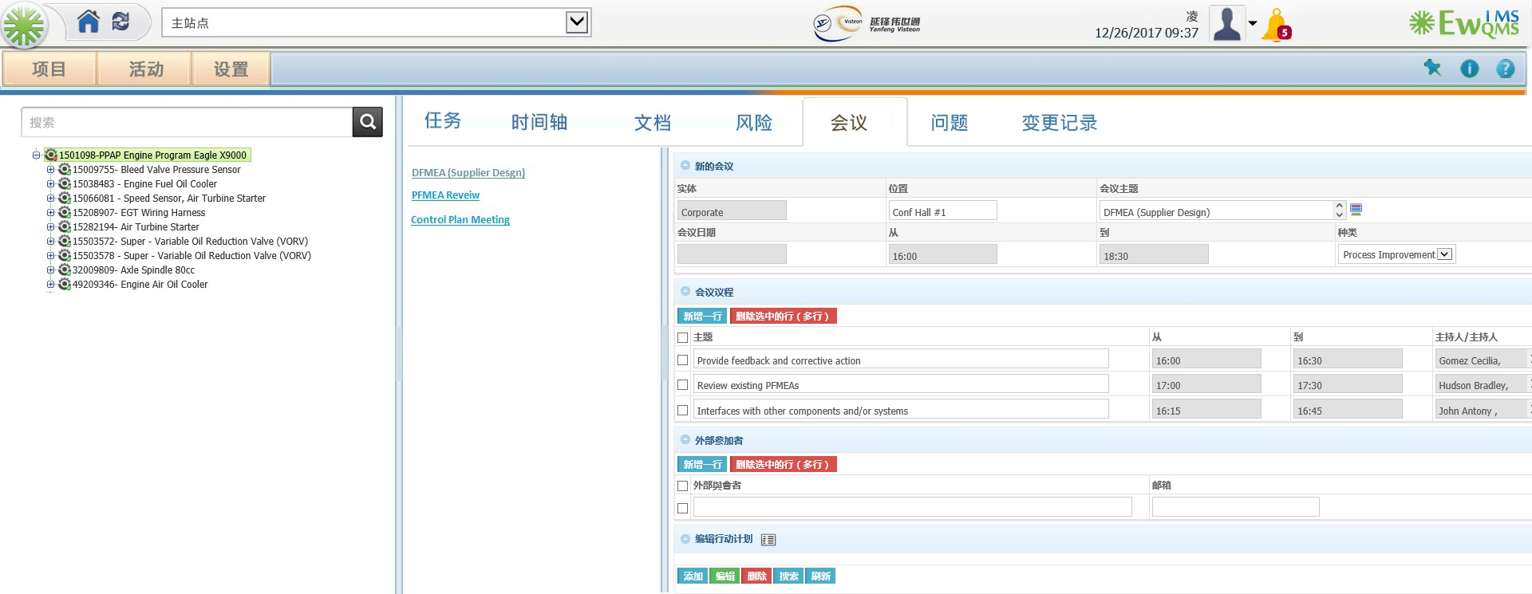

Slide 22
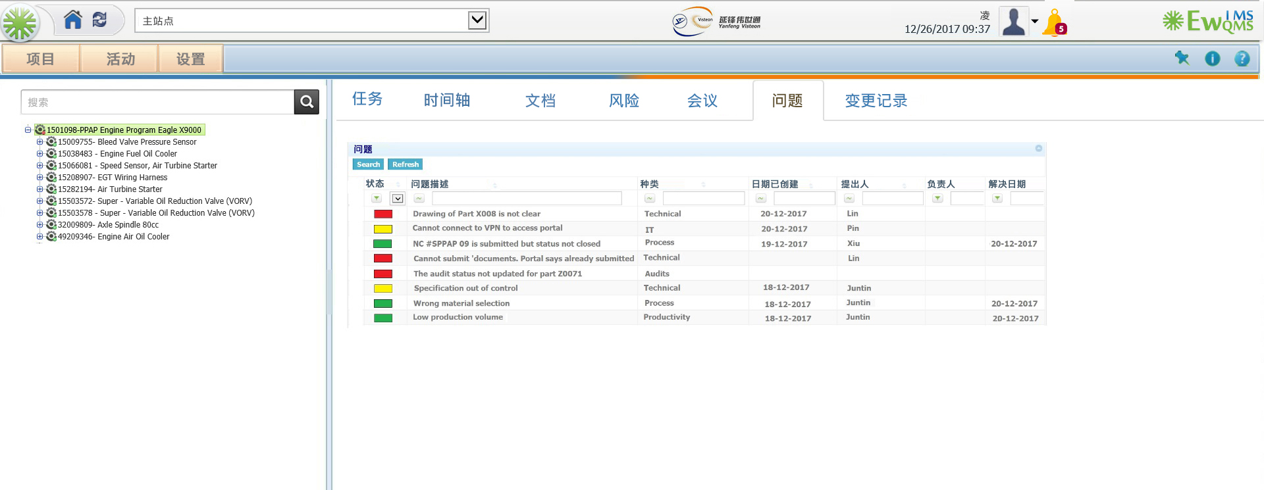

Slide 23
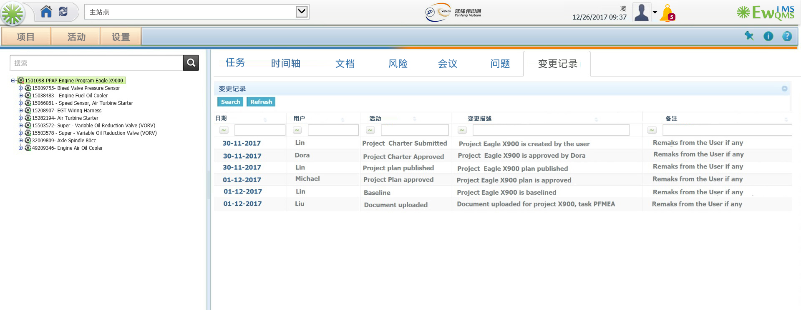

Slide 24
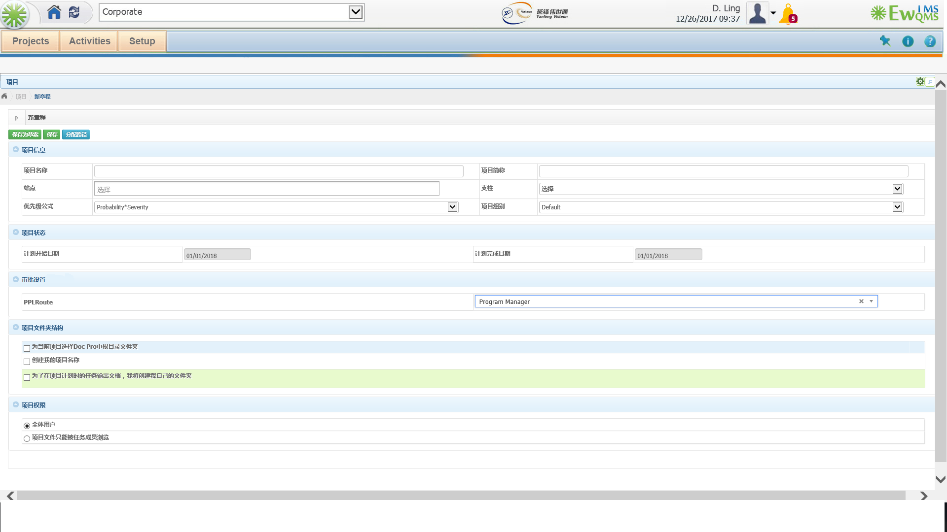
Project Charter/ 项目初始化

Slide 25
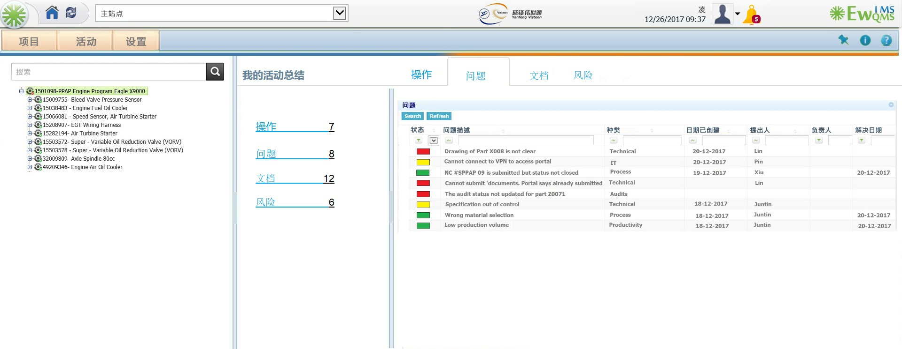
My Activities/我的任务列表

Slide 26
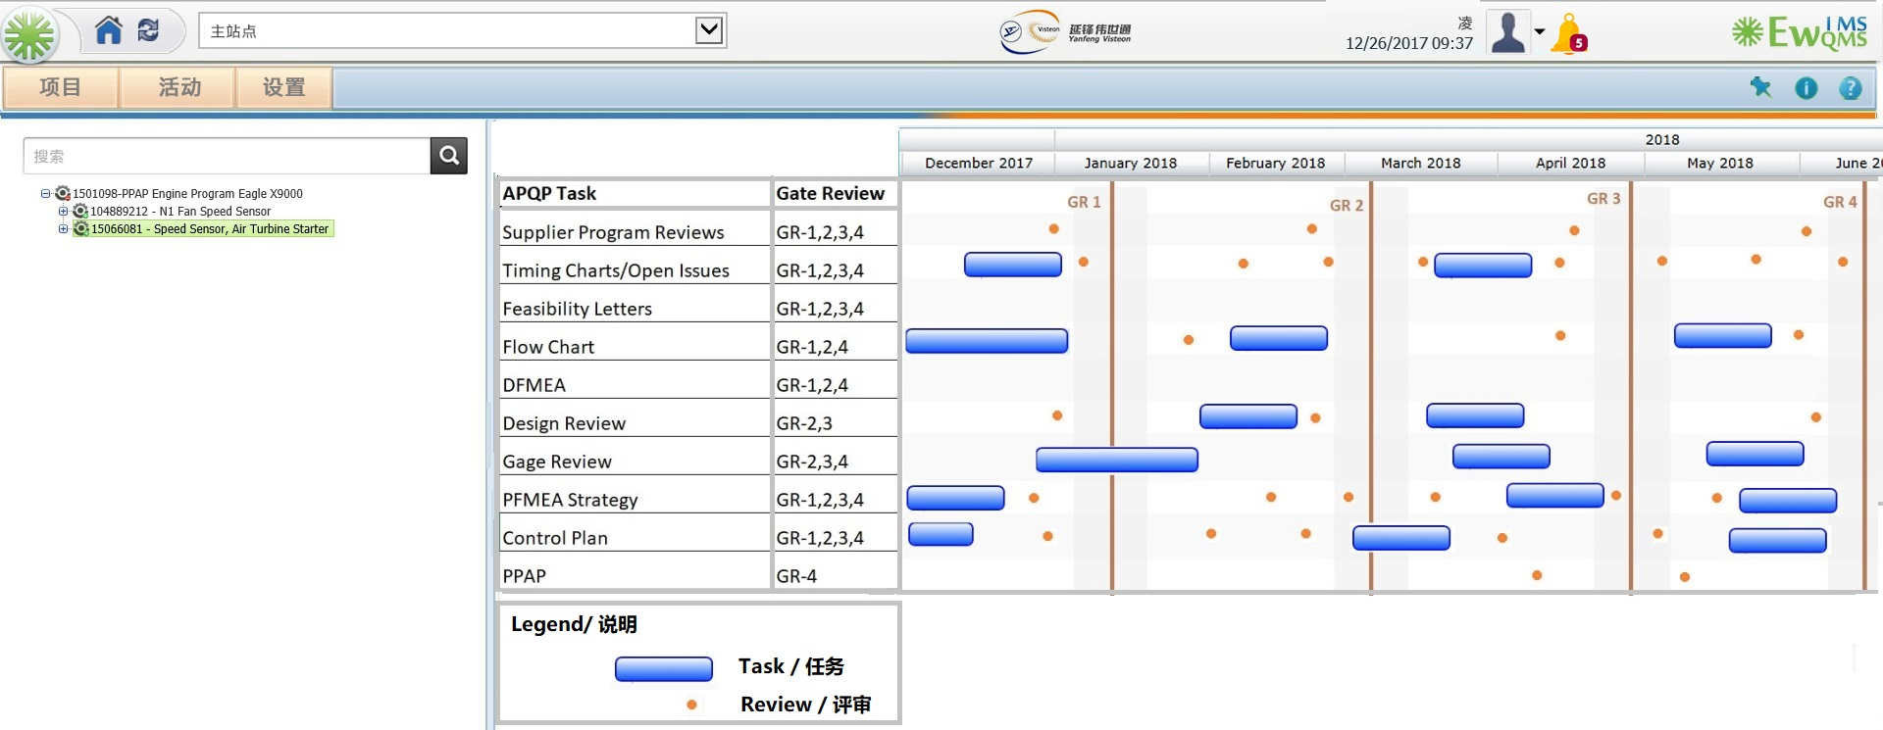

Slide 27
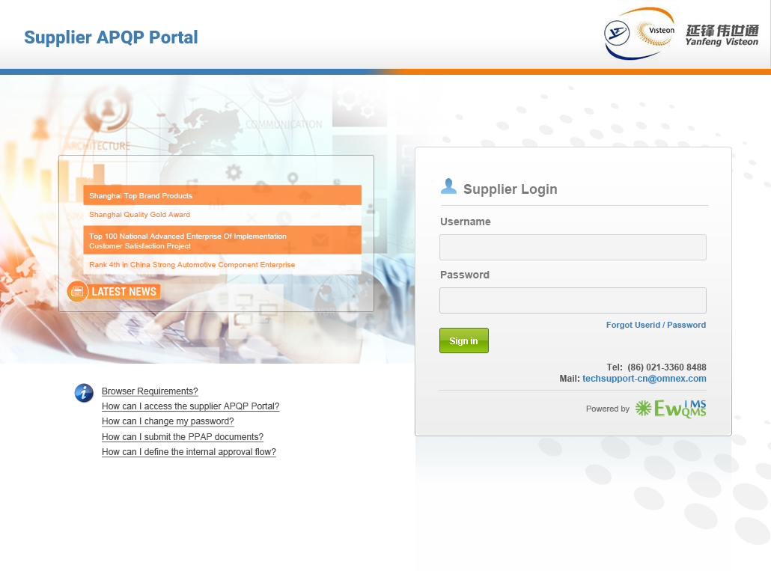


Slide 28
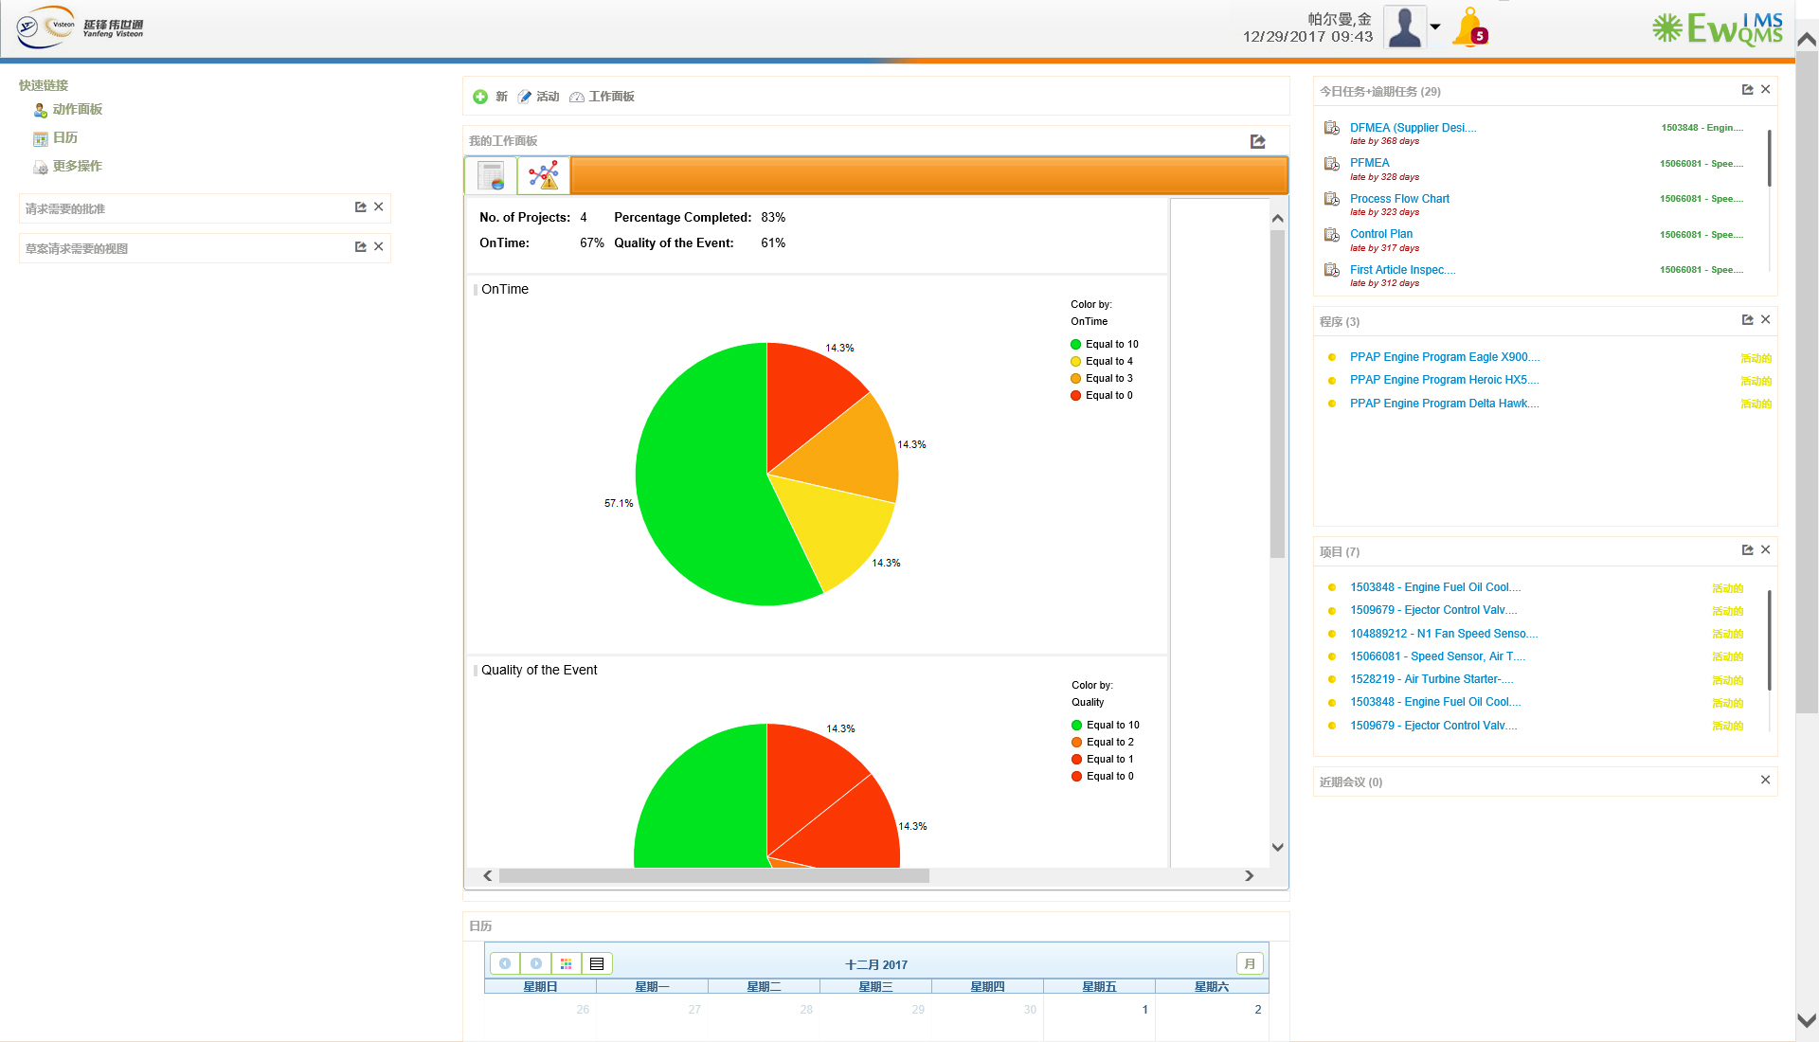

Slide 29
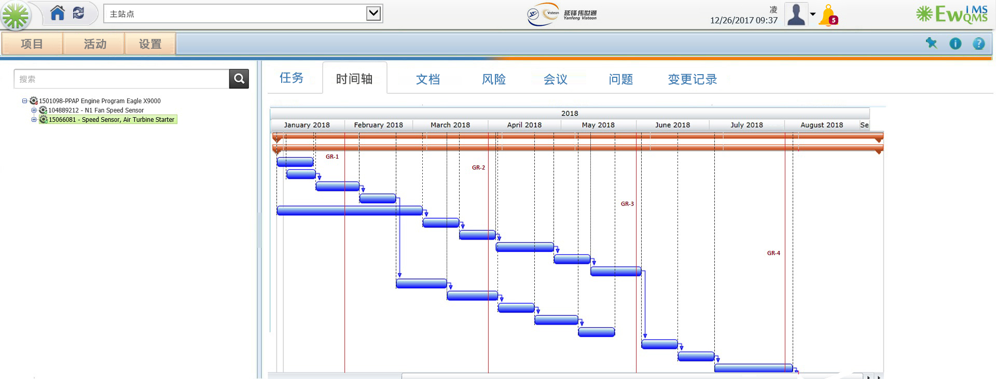

Slide 30
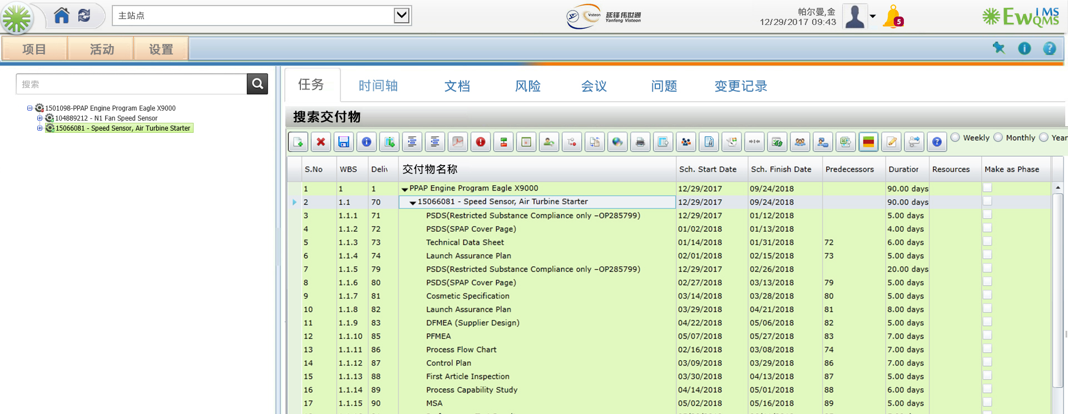

Slide 31
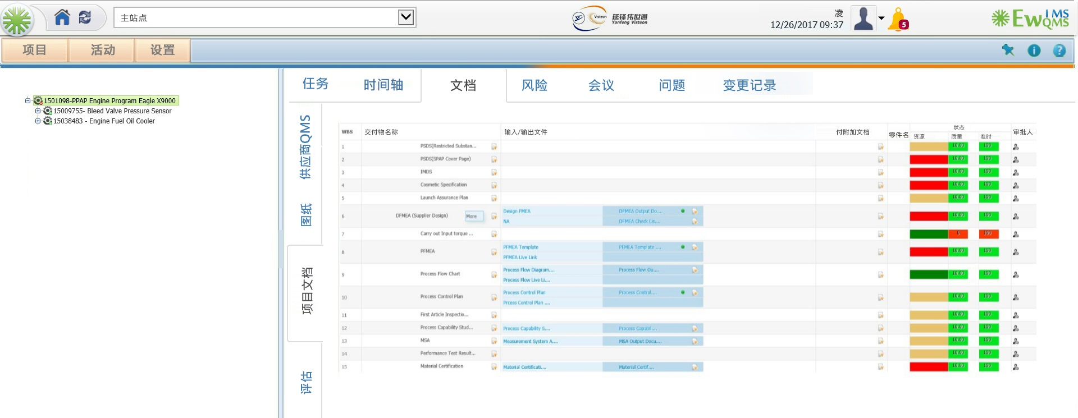

Slide 32
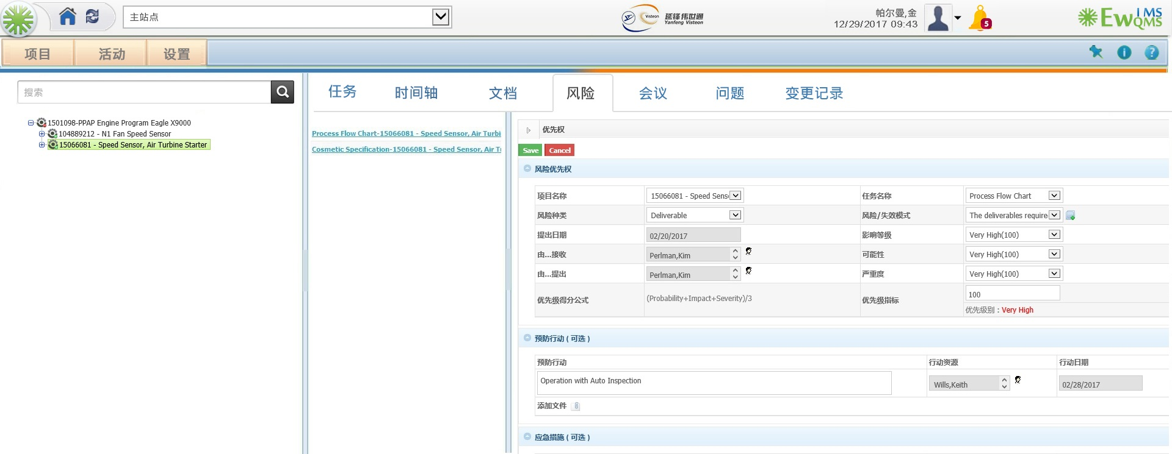

Slide 33
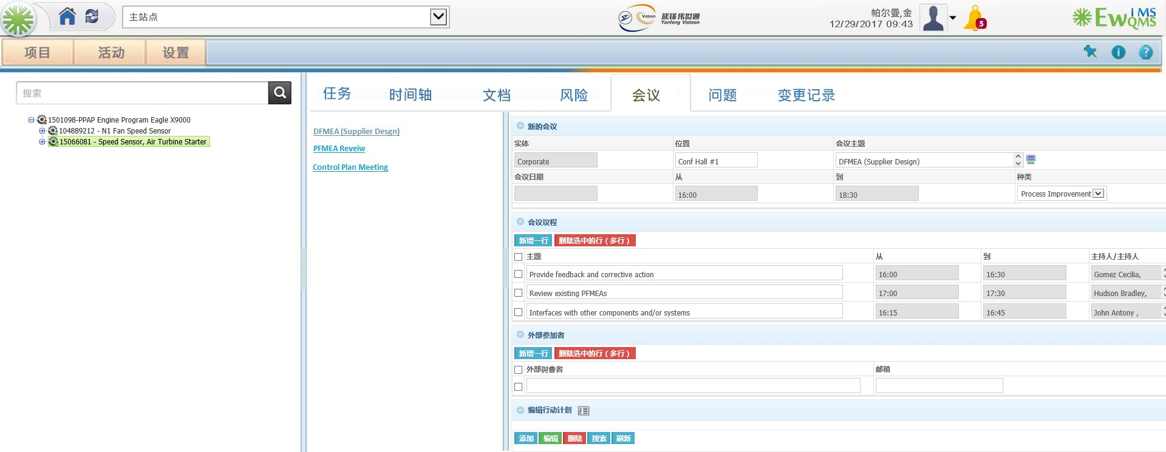

Slide 34
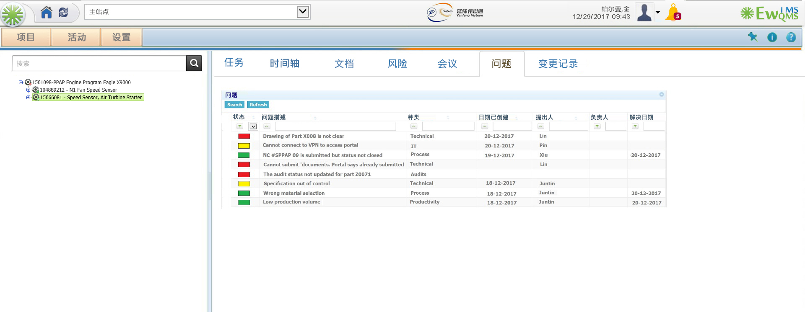

Slide 35
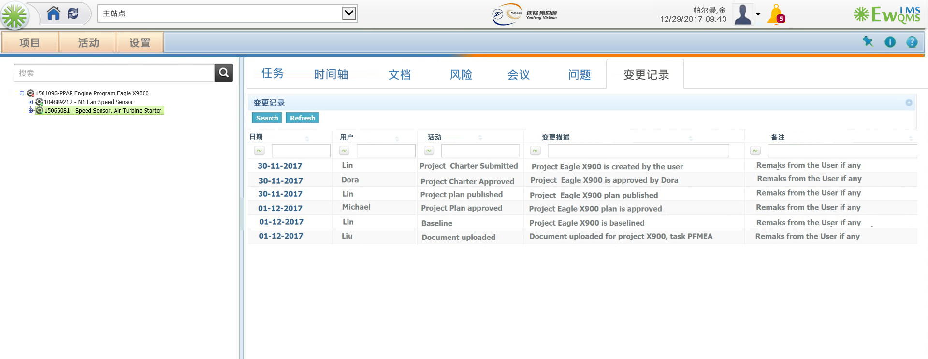

Slide 36

Project Status / 项目状态

Slide 37
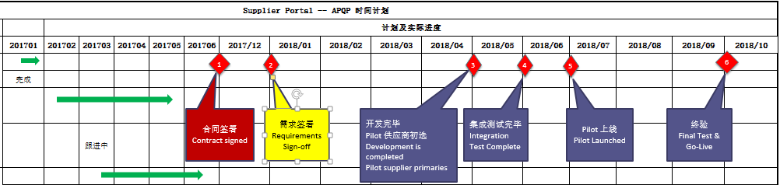
Yanfeng Supplier APQP Portal - Current Status of the Project 延锋供应商APQP入口-当前项目状态
Initial Requirements Study Completed.
Contract is yet to be Signed.
Business Continuity document to be submitted – OMNEX (Jan 4th)
Confidentiality Information to be submitted – OMNEX (Jan 4th)
Technical Support & SLA to be submitted – OMNEX (Jan 4th)
 | Closed/关闭 | Pending/ 待处理 | Open/ 开着 | Grand Total/ 总计
Count of Status/状态计数 | 7 | 22 | 2 | 31

Slide 38
Key Milestones / 关键里程碑

Slide 39

Global Delivery Model / 全球交付模式
Global Software Development Centre – USA, China and India

Slide 40

Thank you / 谢谢

